Slide 1
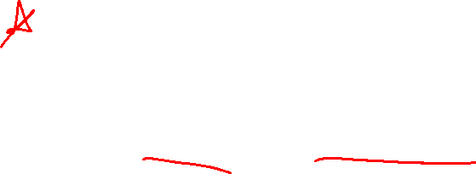
Section 2.2 Limit of a Function
Lecture 2
One-sided and infinite limits
Notes:
Section is shorter than most

Slide 2
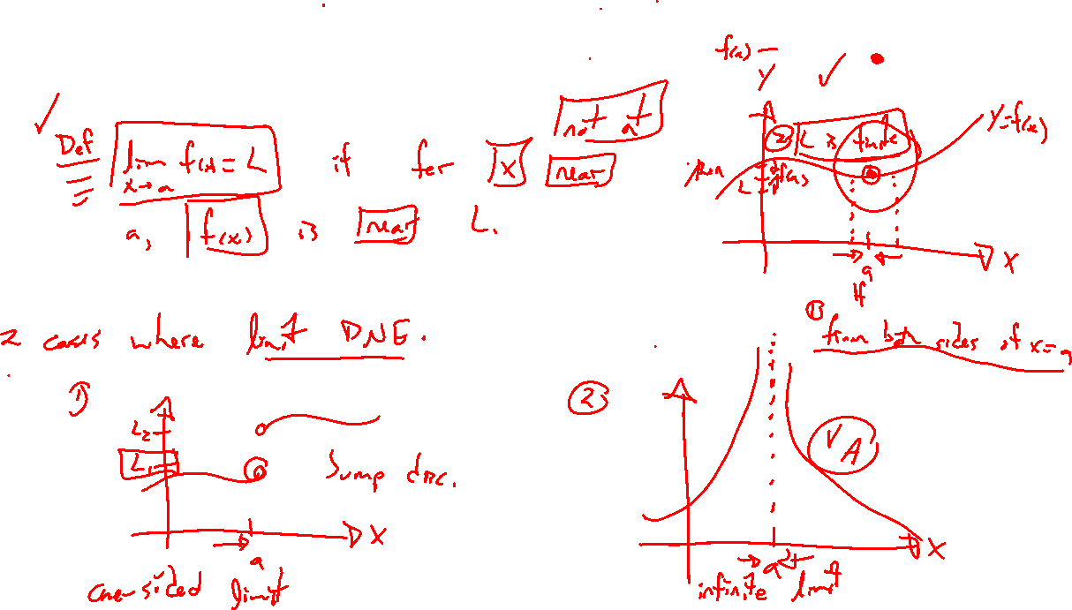
Reminder: Idea of limit
Notes:
Situations where doesn't exist, can still make some sense of.

Slide 3
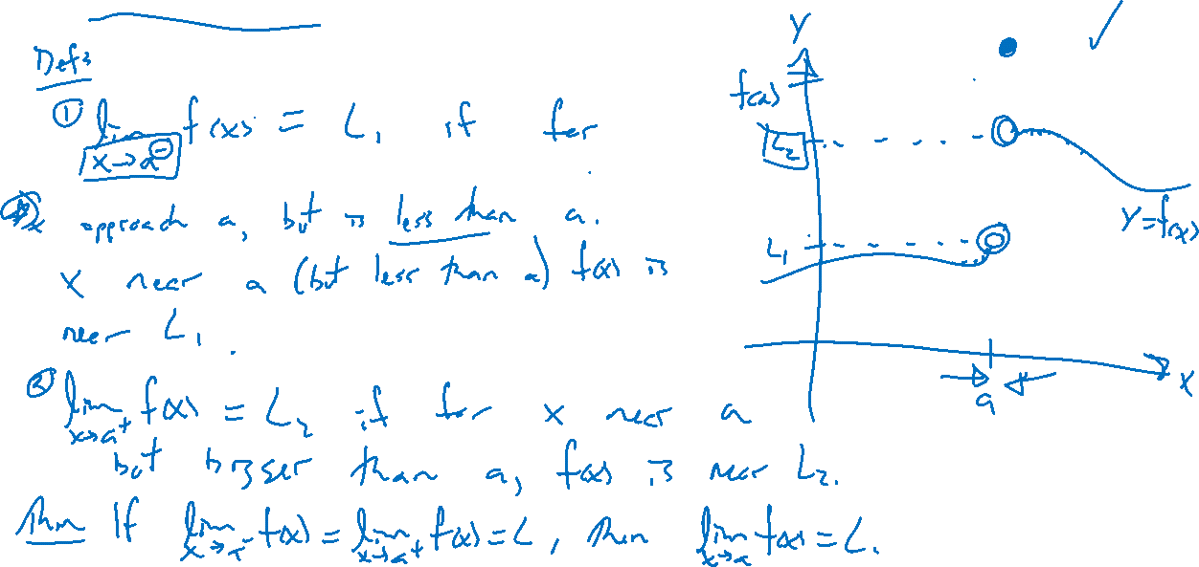
One-sided limits
Notes:
Draw picture with jump disc.
Right and left side limit notation. Again, f(x) doesn't matter.
If they differ, regular limit doesn’t exist. If agree, so does regular limit.

Slide 4
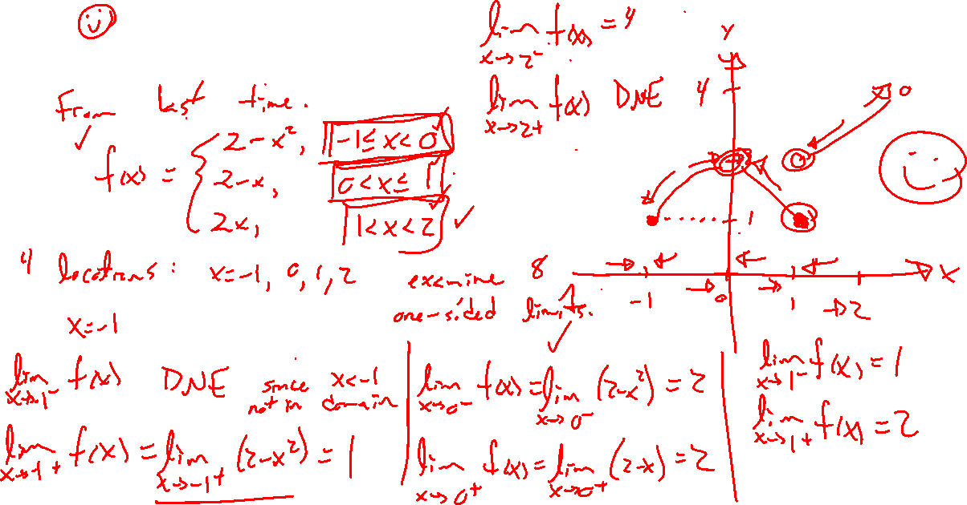
Example: Try on own
Notes:
Previous example, discuss one sided limits.
F(x) = 2-x^2 (-1<=x<0)
2-x (0<x<=1)
2x (1<x<2)

Slide 5
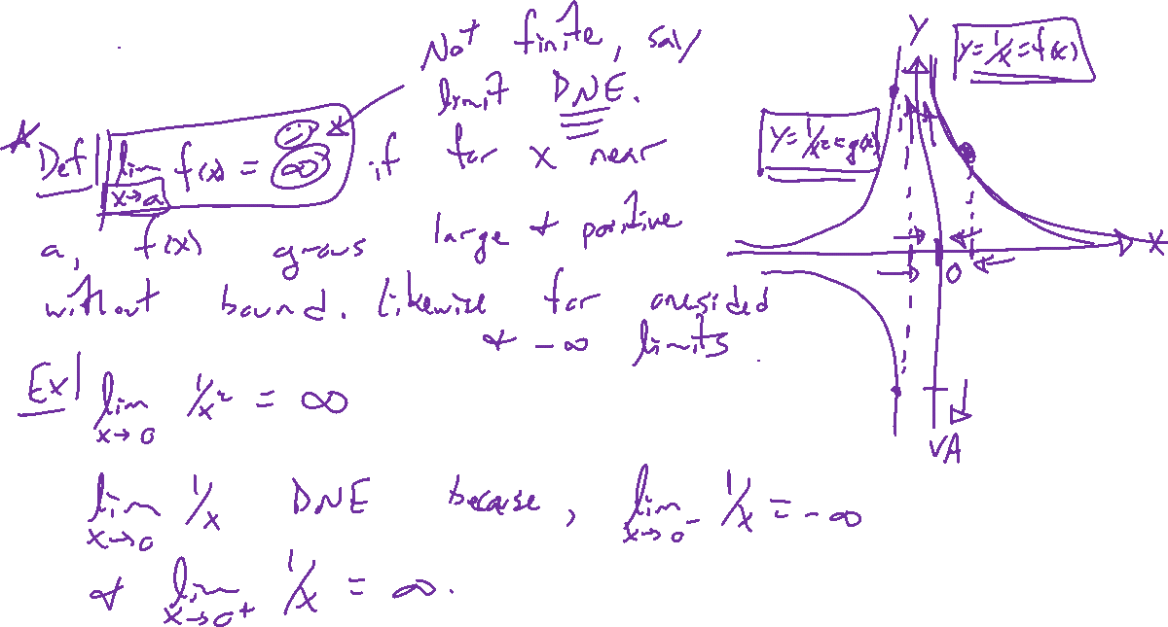
Infinite limits
Notes:
Motivating examples: f(x)=1/x, 1/x^2
Def of lim_{x \rightarrow a} = +- \infty
Right / left limits can be one-sided, if agree get regular limit.
Have seen this before: VAs, bottom zero, top not
If limit is infty, still say limit DNE

Slide 6
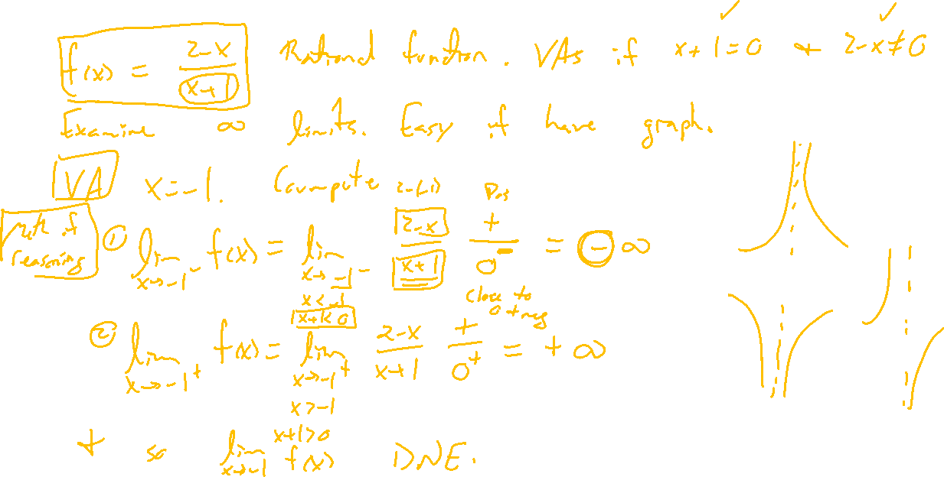
Example:
Notes:
F(x) = (2-x)/(x+1)
Check in Desmos

Slide 7
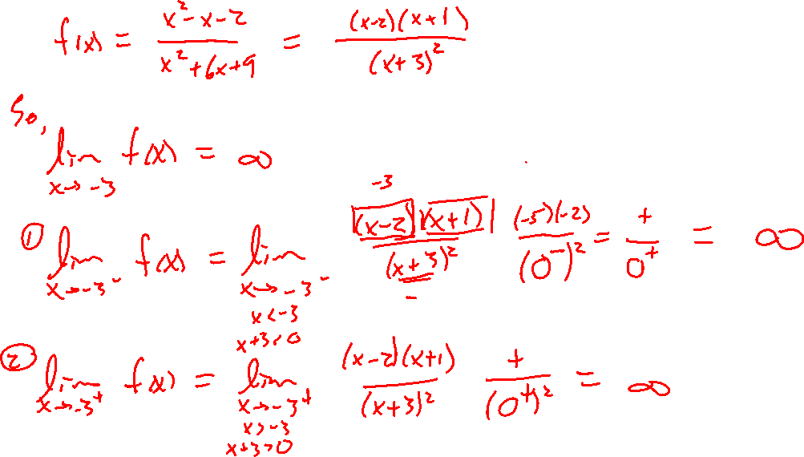
Example: Try on own
Notes:
F(x) = (x+1)(x-2)/(x+3)^2 = (x^2-x-2)(x^2+6x+9)

Slide 8
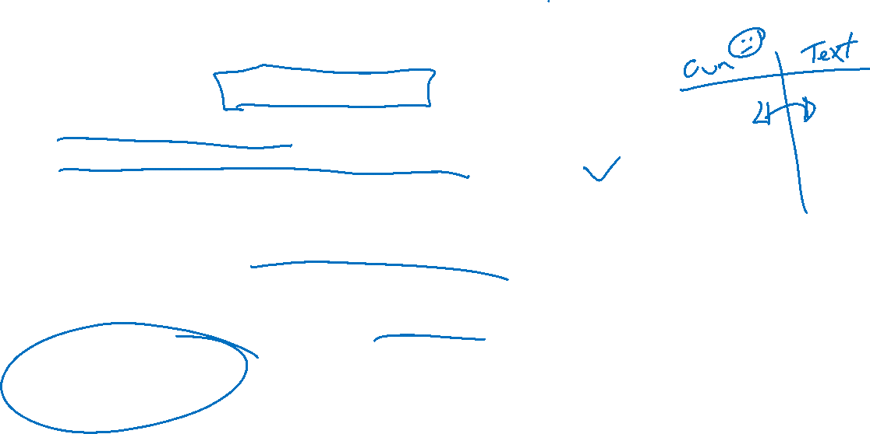
Section 2.2: Textbook Examples and Exercises
Rework examples 1, 2, 6, 7, 9, 10 in the text. Steps:
Write down a problem.
Close the book and attempt on own.
Check / correct your solution against the text solution.
If needed, rewrite the problem to be of the quality of the text solution.
Complete exercises 5, 9, 11, 17, 33, 41
Write solutions of the same quality as in lecture and text solutions.
Check your solution against the answer in the back of the book.
Video reflection
None

Slide 9
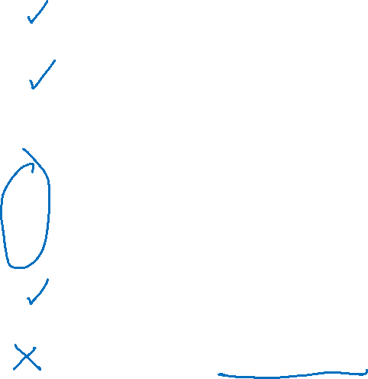
Homework Submission to Canvas
Preview of section
Skim the section in text and write a short paragraph summary.
Give a bulleted list of all important definitions, theorems, and formulas without details.
Notes on video lectures
Take notes on everything written on slides including all details, worked examples, on-own activities, as well as your own thoughts and questions.
Try on-own activities first, then write down provided solution next to it for comparison.
Worked examples from the text
Write down the problem and attempt without looking at the solution.
Use the solution to write the best explanation you can.
Solutions to textbook exercises
Model approaches and explanations given in the video lectures and textbook examples.
Final reflection of section
List the key takeaways to remember as a bulleted list.
Video reflection (for some sections)
Write a 1 paragraph reflection on the video discussing what you found most interesting or useful.
Notes:
Mention graded for completion and quality of writing.

